Slide 1



UNIT 3: School
Fun with science!

Slide 2
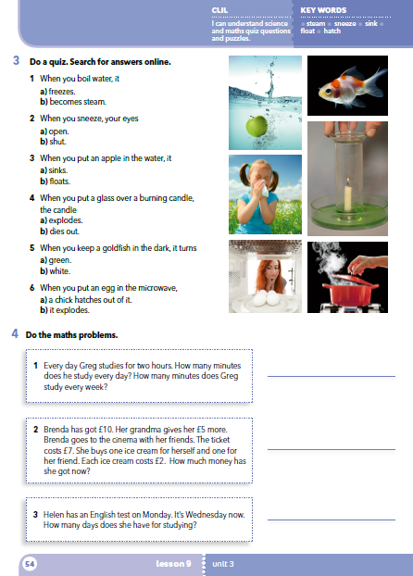
Do you like science?
Do you like maths?
Why? / Why not?
Who’s good at science?
Who’s good at maths?

Slide 3
Translate
boil = float =
steam = die out =
sneeze = hatch =
sink = freeze =
ključati
plutati
para
ugasiti se
kihati
izleći se
tonuti
smrzavati se

Slide 4
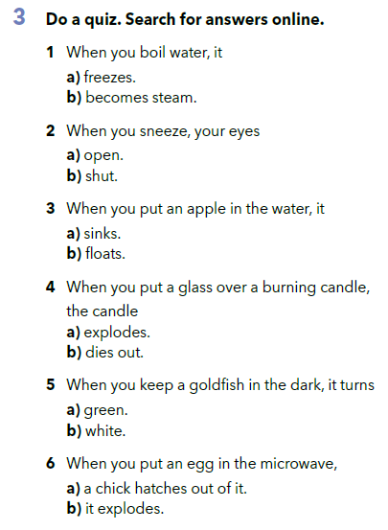

Slide 5
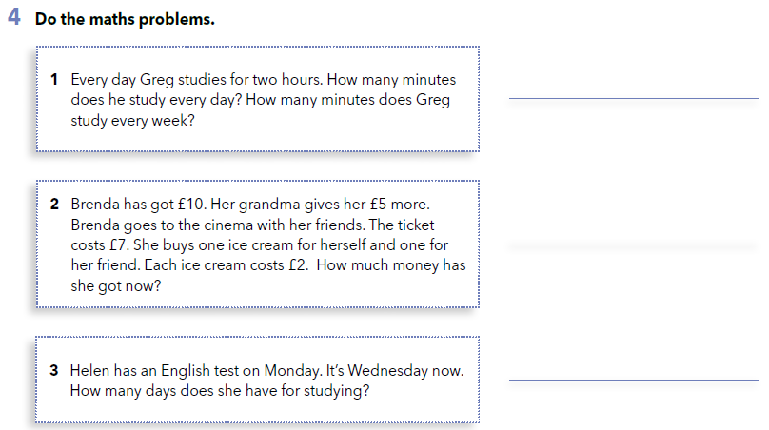
120 minutes every day, 840 minutes every week.
£4
4 days.

Slide 6
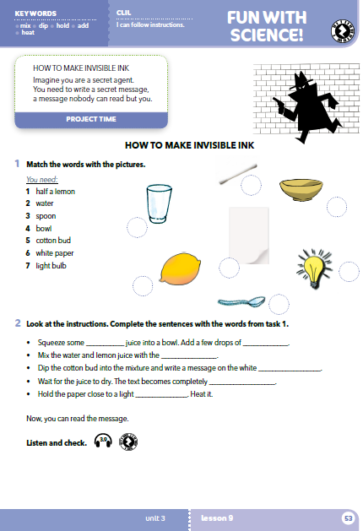
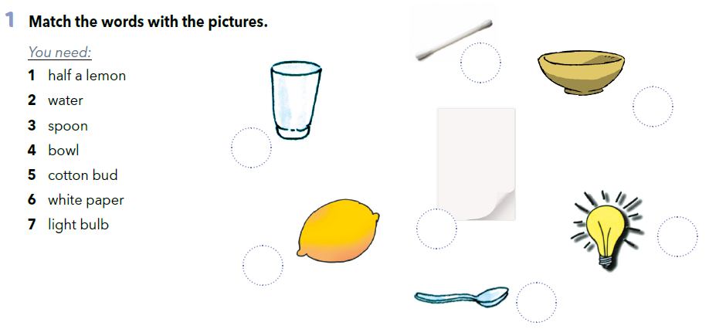
5
4
2
6
7
1
3

Slide 7
Translate
mix – squeeze -
dip – add -
hold – heat –
a few drops – dry –
miješati
iscijediti
umočiti
dodati
držati
zagrijati
nekoliko kapi
osušiti (se)

Slide 8
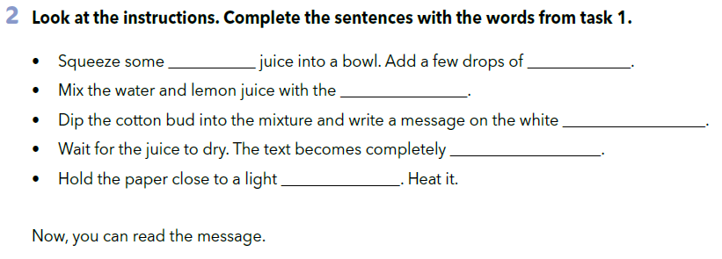

lemon
water
spoon
paper
invisible
bulb
https://www.e-sfera.hr/dodatni-digitalni-sadrzaji/9bdbaff5-5dd4-4aea-b9e5-a49d2f50f0e7/assets/audio/3_9__invisible_ink.mp3
Listen and check your answers.

Slide 9
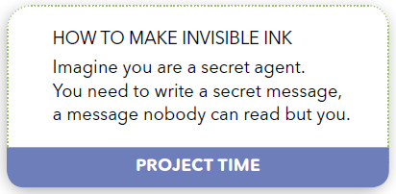
PROJECT TIME

